Slide 1

CHAPTER - 2
Network Models
Part-1

Slide 2
The need for standards
Over the past couple of decades many of the networks that were built used different hardware and software implementations, as a result they were mismatched and it became difficult for networks using different specifications to communicate with each other.
To address the problem of networks being mismatched and unable to communicate with each other, the International Organisation for Standardisation (ISO) researched various network structures.
The ISO recognised there was a need to create a NETWORK MODEL that would help vendors create interoperable (The ability of different systems, devices, applications or products to connect and communicate in a coordinated way, without effort from the end user) network implementations.
2

Slide 3
2.2 The OSI model
Established in 1947, the International Standards Organization (ISO) is a multinational body dedicated to worldwide agreement on international standards.
An ISO standard that covers all aspects of network communications is the Open Systems Interconnection (OSI) model.
It was first introduced in the late 1970s.
An open system is a set of protocols that allows any two different systems to communicate regardless of their underlying architecture.
Open” means the concepts are non-proprietary; can be used by anyone.
3

Slide 4
Cont.
The purpose of the OSI model is to show how to facilitate communication between different systems without requiring changes to the logic of the underlying hardware and software.
The OSI model is not a protocol; it is a model for understanding and designing a network architecture that is flexible, robust, and interoperable.
ISO is the organization and OSI is the model
4

Slide 5
Cont.
The OSI model is a layered framework for the design of network systems that allows communication between all types of computer systems. It consists of seven separate but related layers, each of which defines a part of the process of moving information across a network.
There are 7 layers in the OSI model. Each layer is responsible for a particular aspect of data communication.
For example, one layer may be responsible for establishing connections between devices, while another layer may be responsible for error checking during transfer.
5

Slide 6
A layered network model
The OSI Reference Model is composed of seven layers, each specifying particular network functions.
The process of breaking up the functions or tasks of networking into layers reduces complexity.
Each layer provides a service to the layer above it in the protocol specification.
Each layer communicates with the same layer’s software or hardware on other computers.
This is similar to the concept of a function in programming languages – function does a specific task.
6

Slide 7
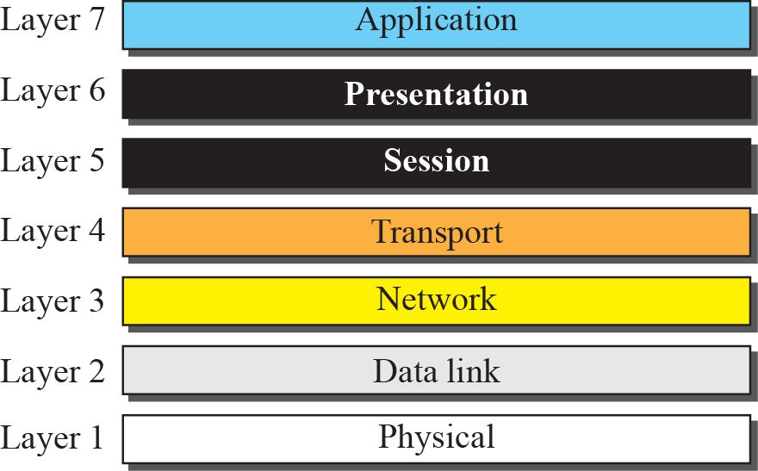
Layered Architecture
7

Slide 8
Cont.
All
People
Seem
To
Need
Data
Processing
Application
Presentation
Session
Transport
Network
Data Link
Physical
Anytime
Passwords
Secrete
Tell
Not
Do
Please
8

Slide 9
Cont.
The lower 4 layers (transport, network, data link and physical —Layers 4, 3, 2, and 1) are concerned with the flow of data from end to end through the network.
The upper three layers (application, presentation and session—Layers 7, 6 and 5) are orientated more toward services to the applications. (such as user interfacing and data formatting)
Data is Encapsulated with the necessary protocol information as it moves down the layers before network transit.
Actual data communication takes place through the lowest layer – the physical layer
9

Slide 10

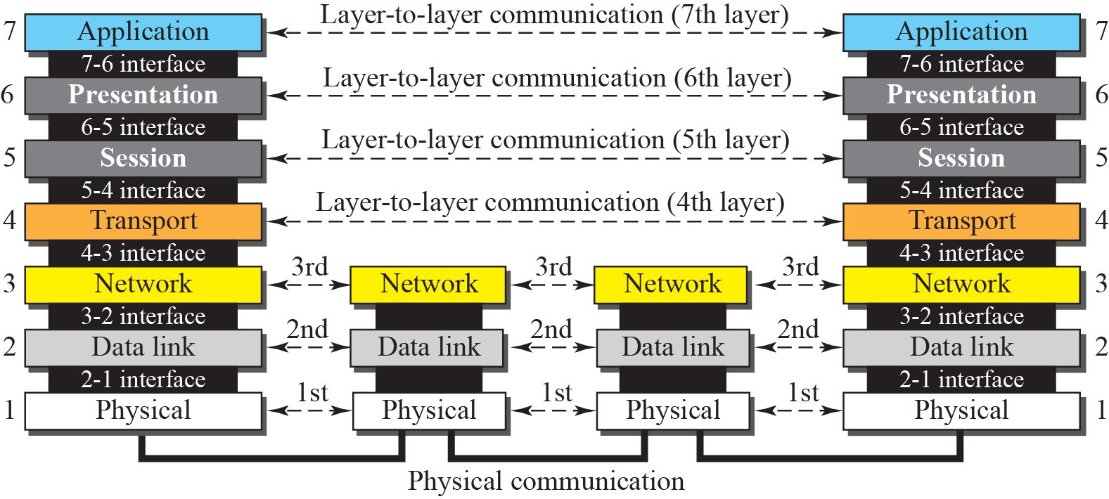
Peer-to-Peer Processes
10

Slide 11
Cont.
At the physical layer, communication is direct: In Figure, device A sends a stream of bits to device B (through intermediate nodes).
At the higher layers, however, communication must move down through the layers on device A, over to device B, and then back up through the layers.
Each layer in the sending device adds its own information to the message it receives from the layer just above it and passes the whole package to the layer just below it.
11

Slide 12
Cont.
At layer 1 (physical layer) the entire package is converted to a form that can be transmitted to the receiving device.
At the receiving machine, the message is unwrapped layer by layer, with each process receiving and removing the data meant for it.
For example, layer 2 removes the data meant for it, then passes the rest to layer 3. Layer 3 then removes the data meant for it and passes the rest to layer 4, and so on.
12

Slide 13
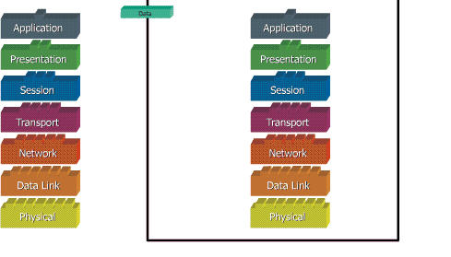
Cont.
13

Slide 14
Data Transmission Process
When the end user sends data, that data will go through all seven layers of the OSI model.
The data is broken into smaller and smaller parts beginning at Layer 4 (the Transport Layer) until it's in the form of electric signals that can be sent across the physical media.
As the data flows down the OSI model, it's refered to by different terms.
14

Slide 15
Cont.
At Application, Presentation, and Session layers, data is simply called ”Data”.
At the Transport layer, data is placed into segments.
At the Network layer, data is placed into packets.
At the Data Link layer, data is placed into frames.
Finally, at the Physical layer, data takes the form of bits, and it's all 1s and 0s.
15

Slide 16
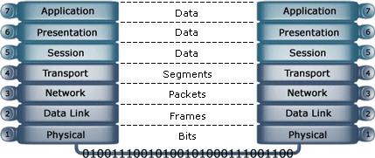
Cont.
16

Slide 17
Organization of the Layers
The seven layers can be thought of as belonging to three subgroups.
Layers 1, 2, and 3-physical, data link, and network-are the network support layers; they deal with the physical features of moving data from one device to another (such as electrical specifications, physical connections, physical addressing, and transport timing and reliability).
Layers 5, 6, and 7-session, presentation, and application-can be thought of as the user support layers; they allow interoperability among unrelated software systems.
Layer 4-transport layer, links the two subgroups and ensures that what the lower layers have transmitted is in a form that the upper layers can use.
17

Slide 18
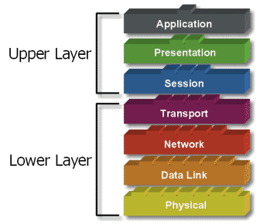
Cont.
The upper OSI layers
are almost always
implemented in software.
The lower layers are a
combination of hardware
and software, except for
the physical layer, which
is mostly hardware.
18

Slide 19
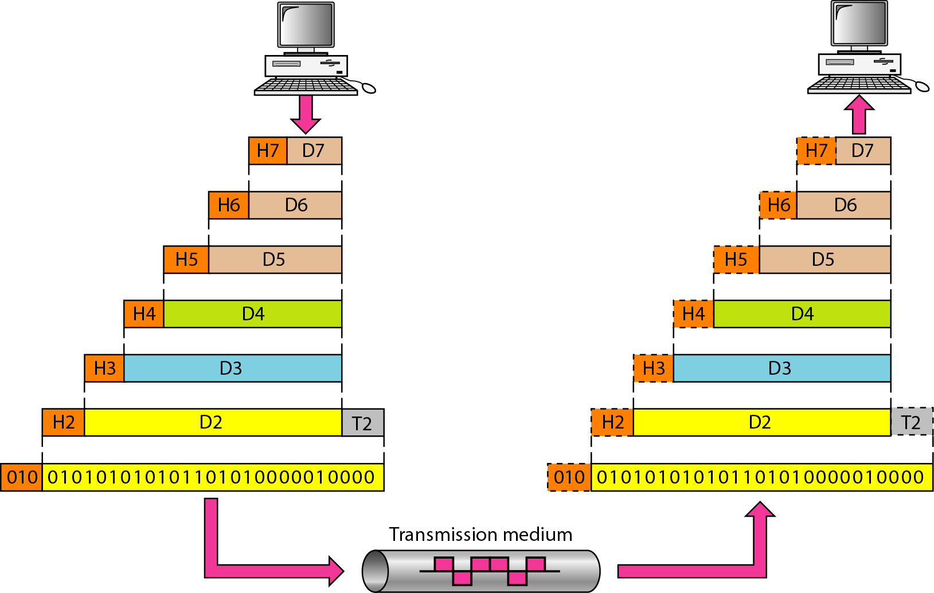
An exchange using the OSI model
D7 means the data unit at layer 7,
D6 means the data unit at layer 6, and so on.
19

Slide 20
Cont.
The process starts at layer 7 (the application layer), then moves from layer to layer in descending, sequential order.
At each layer, a header, or possibly a trailer, can be added to the data unit.
Commonly, the trailer is added only at layer 2.
When the formatted data unit passes through the physical layer (layer 1), it is changed into an electromagnetic signal and transported along a physical link.
Header and trailer provide source and destination addresses, synchronization points, information for error detection, etc.
20

Slide 21
Cont.
Upon reaching its destination, the signal passes into layer-1 (physical layer) and is transformed back into digital form.
The data units then move back up through the OSI layers.
As each block of data reaches the next higher layer, the headers and trailers attached to it at the corresponding sending layer are removed, and actions appropriate to that layer are taken.
By the time it reaches layer-7, the message is again in a form appropriate to the application and is made available to the recipient.
21

Slide 22
Cont.
22

Slide 23
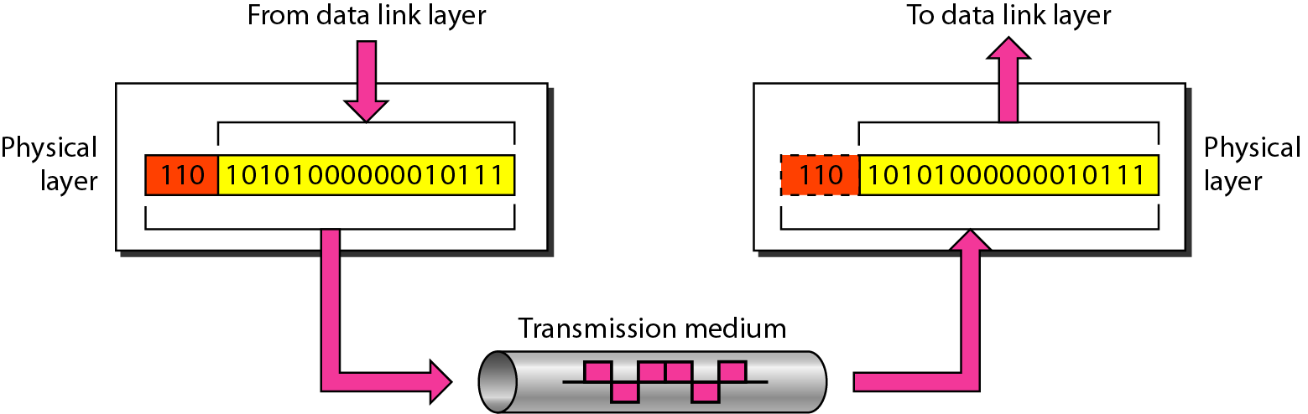
Physical Layer
The physical layer is responsible for movements of
individual bits from one hop (node) to the next.
23

Slide 24
Functions of Physical Layer
Physical characteristics | : | Interface between the device and the transmission medium.
Bit representation | : | Encode bits into electrical or optical signals.
Transmission rate | : | The number of bits sent each second.
Synchronizing | : | The sender and receiver bit rate must be synchronized at the bit level.
Line configuration | : | Type of connection. i.e. point-to-point, multipoint.
Physical Topology | : | How devices are connected – ring, star, mesh, bus topology.
Transmission mode | : | Simplex, half-duplex, full duplex.
24

Slide 25
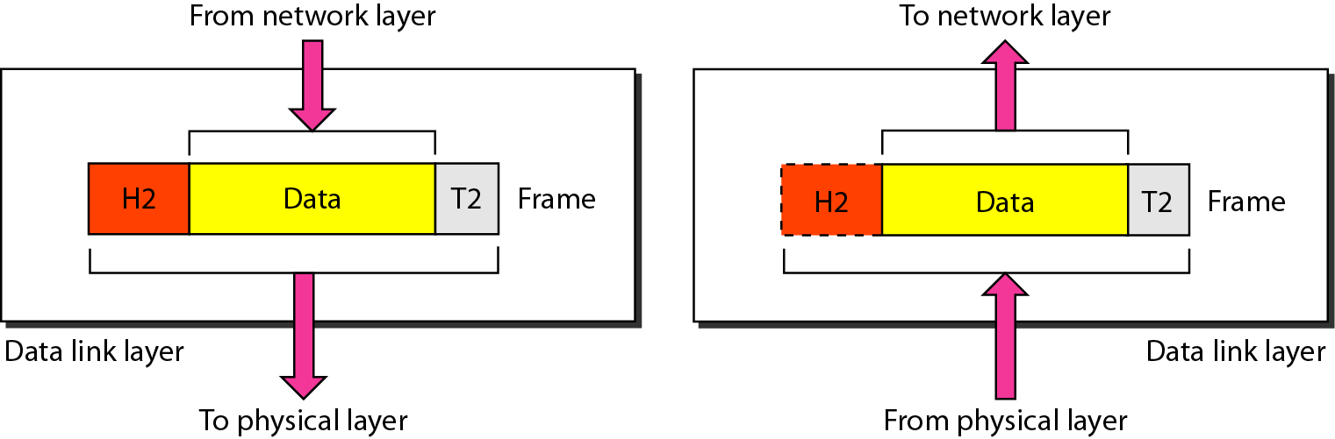
Data Link Layer
The data link layer is responsible for moving frames from one hop (node) to the next.
25

Slide 26
Functions of Data Link Layer
Framing | : | Divides the stream of bits received from network layer into manageable data units called frames.
Physical Addressing | : | Add a header to the frame to define the physical address of the source and the destination machines.
Flow control | : | Impose a flow control rate at which data is transmitted so as not to flood the receiver.
Error Control | : | Adds mechanisms to detect and retransmit damaged or lost frames. This is achieved by adding a trailer to the end of a frame.
Access control | : | When two or more devices are connected to the same link, data link layer protocols are necessary to determine which device has control over the link at any given time.
26

Slide 27
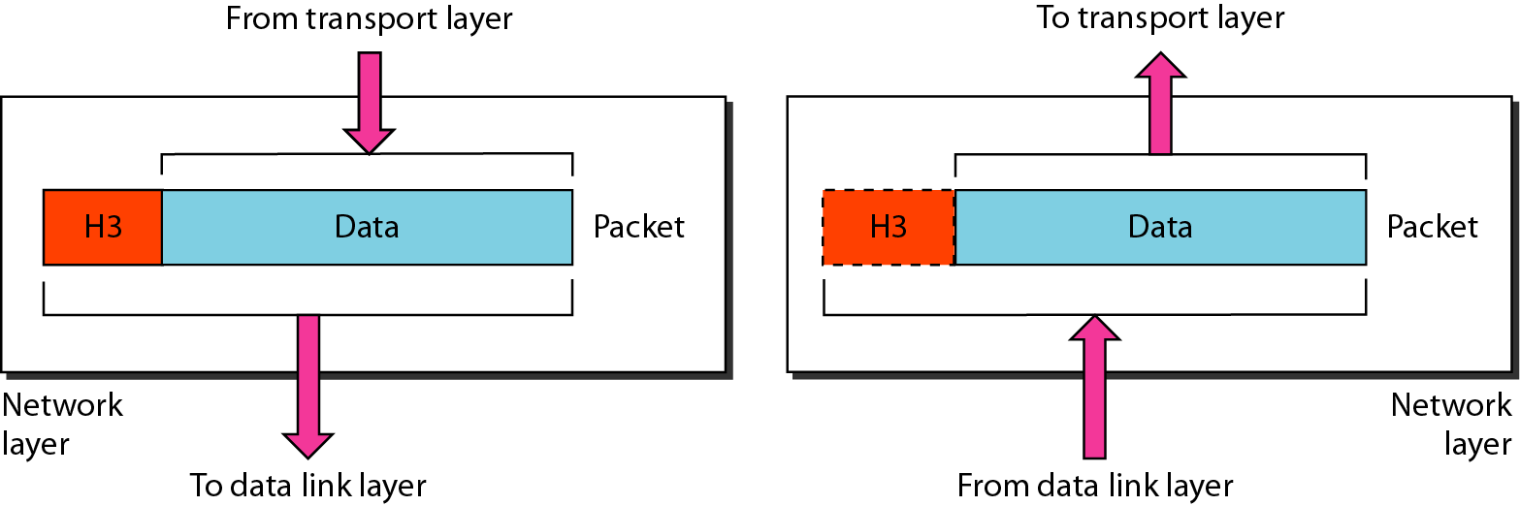
Network layer
The network layer is responsible for the delivery of individual packets from
the source host to the destination host.
27

Slide 28
Functions of Network layer
Logical addressing | : | The network layer adds a header to the packet coming from the upper layer that, among other things, includes the logical addresses of the sender and receiver.
Routing | : | When independent networks or links are connected to create inter networks (network of networks) or a large network, the connecting devices (called routers or switches) route or switch the packets to their final destination. One of the functions of the network layer is to provided this mechanism.
28

Slide 29
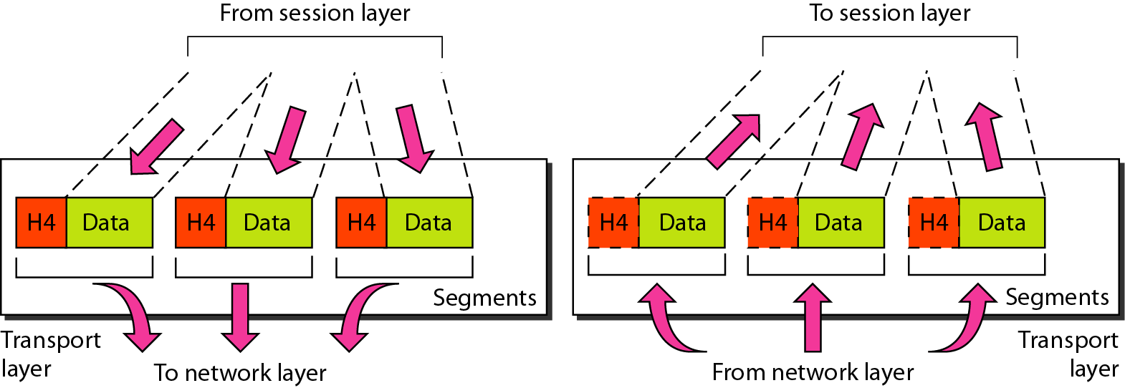
Transport Layer
The transport layer is responsible for the delivery of a message from one process to another.
29

Slide 30
Functions of Transport Layer
Service Point Addressing | : | Transport layer makes sure that the message is delivered to the correct process on destination machine.
Segmentation and Reassembly | : | Divide the message received from session layer into segments and number them to make a sequence for reassembly at the receiving side.
Error Control | : | Make sure that the entire message arrives without errors else retransmit.
Flow Control | : | Transport layer makes sure that the sender and the receiver communicate at a rate they both can handle.
30

Slide 31
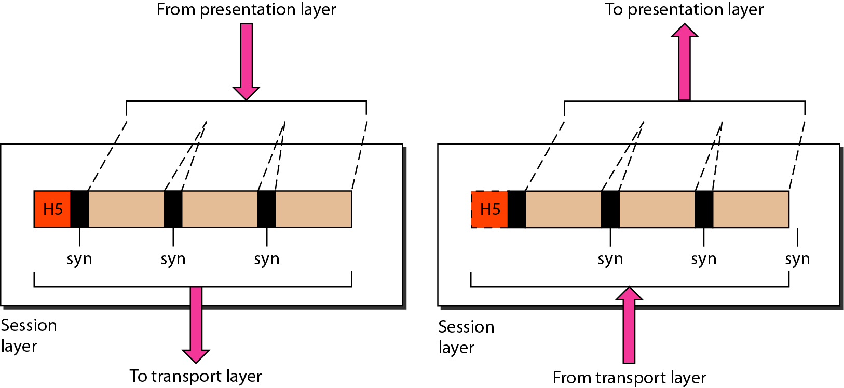
Session Layer
The session layer is responsible for dialog control and synchronization.
The session layer is responsible for dialog control and synchronization.
31

Slide 32
Functions of Session Layer
Dialog control | : | The session layer allows two systems to enter into a dialog. It allows the communication between two processes to take place in either half-duplex or full-duplex mode.
Synchronization | : | The session layer allows a process to add checkpoints, or synchronization points, to a stream of data. For example, if a system is sending a file of 2000 pages, it is advisable to insert checkpoints after every 100 pages to ensure that each 100-page unit is received and acknowledged independently. In this case if a crash happens during the transmission of page 523, the only pages that need to be resent after system recovery pages 501 to 523. Pages previous to 501 need not be resent.
32

Slide 33
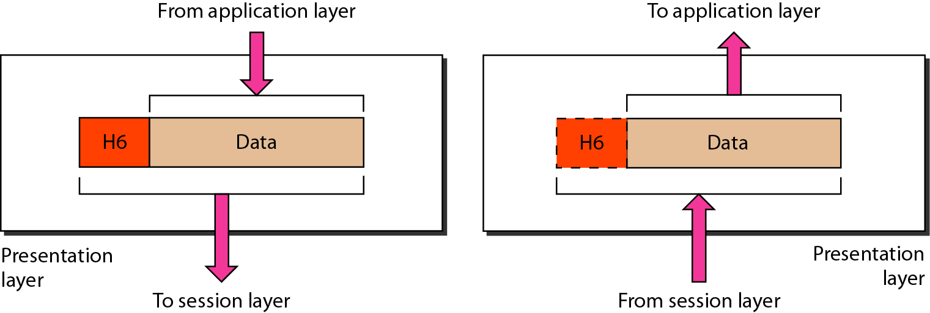
Presentation Layer
The presentation layer is responsible for translation, compression, and encryption.
33

Slide 34
Functions of Presentation Layer
Translation | : | Different computers use different encoding systems. The presentation layer at the sender changes the information from its sender-dependent format into a common format. The presentation layer at the receiving machine changes the common format into its receiver-dependent format.
Data Encryption | : | For security and privacy purpose.
Data Compression | : | Data compression reduces the number of bits contained in the information.
34

Slide 35
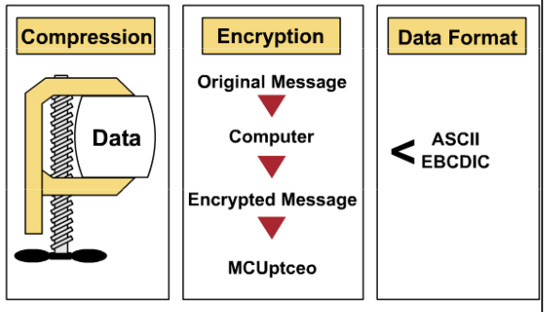
Three main functions
35

Slide 36
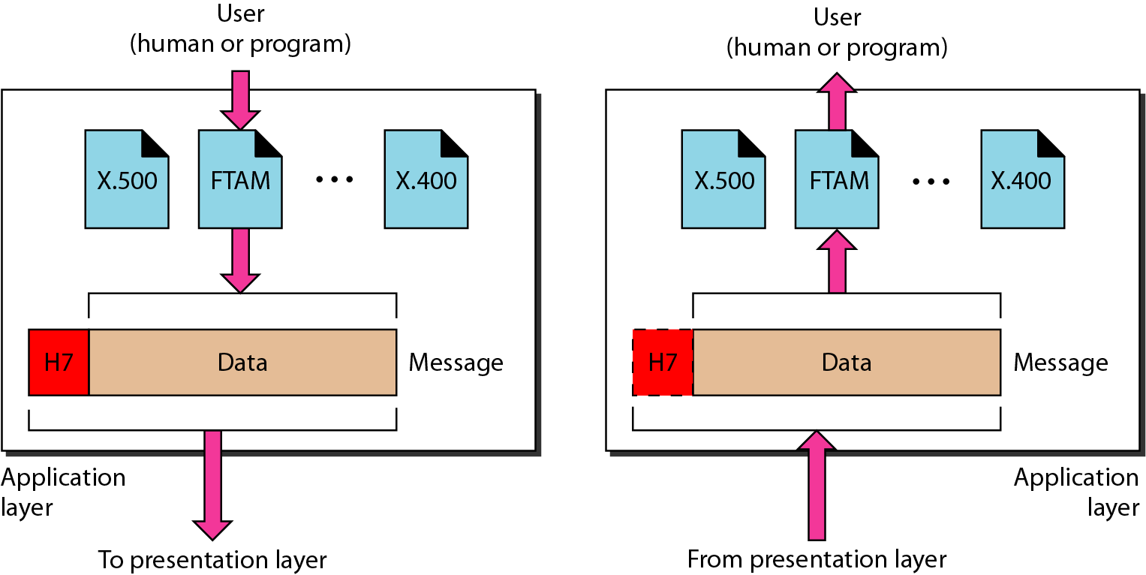
Application Layer
The application layer is responsible for providing services to the user.
36

Slide 37
Functions of Application Layer
Network Virtual terminal | : | A network virtual terminal is a software version of a physical terminal, and it allows a user to log on to a remote host.
File transfer, access, and management | : | This application allows a user to access files in a remote host (to make changes or read data), to retrieve files from a remote computer for use in the local computer, and to manage or control files in a remote computer locally.
Mail Services | : | This application provides the basis for e-mail forwarding and storage.
37

Slide 38
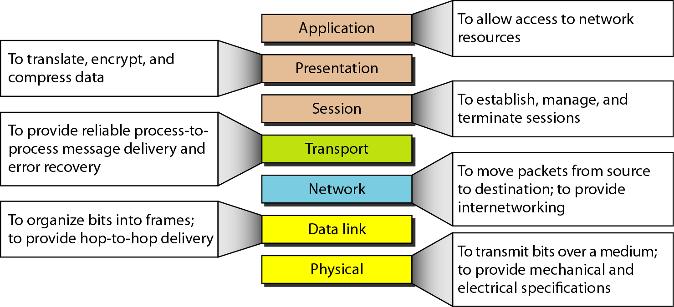
Summary of layers
38

Slide 39
Cont.
OSI Model
 | Data Unit | Layer | Function
Host layers | Data | 7. Application | Network process to application
 |  | 6. Presentation | Data representation, encryption and decryption
 |  | 5. Session | Interhost communication
 | Segments | 4. Transport | End-to-end connections and reliability, Flow control
Media layers | Packet | 3. Network | Path determination and logical addressing
 | Frame | 2. Data Link | Physical addressing
 | Bit | 1. Physical | Media, signal and binary transmission
39

Slide 40
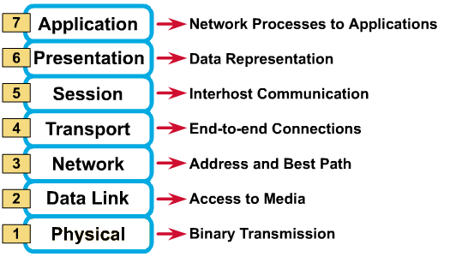
Cont.
40

Slide 41
Cont.
Layer | Responsible For
(7) Application | Provides Services to User Apps
(6) Presentation | Data Representation
(5) Session | Communication Between Hosts
(4) Transport | Flow Ctrl, Error Detection/Correction
(3) Network | End to End Delivery, Logical Address
(2) Data Link | Media Access Ctrl, Physical Address
(1) Physical | Medium, Interfaces, Puts Bits on Medium.
41

Slide 42
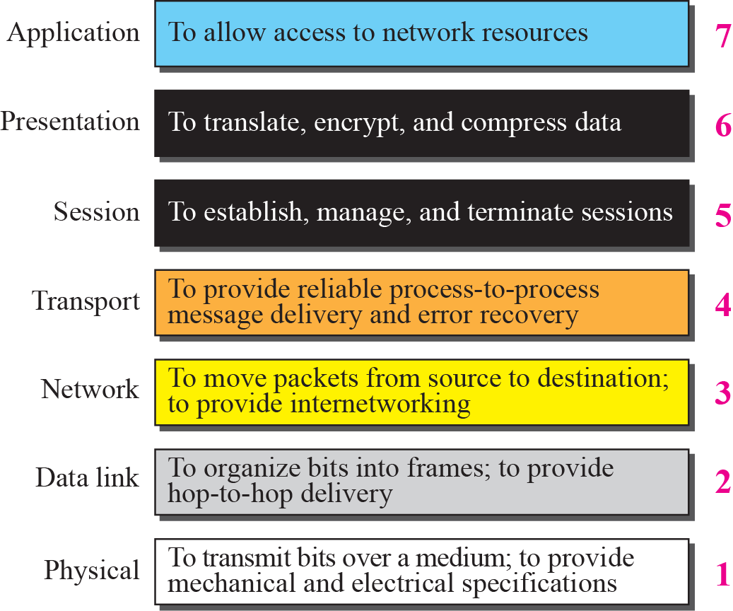
Summary of OSI Layers
42

Slide 43
The Postal Analogy
How would the OSI compare to the regular Post Office
Application | : | Write a 20 page letter to a foreign country.
Presentation | : | Translate the letter so the receiver can read it.
Session | : | Insure the intended recipient can receive letter.
Transport | : | Separate and number pages. Like registered mail, tracks delivery and requests another package if one is “lost” or “damaged” in the mail.
Network | : | Postal Center sorting letters by zip code to route them closer to destination.
Data-Link | : | Local Post Office determining which vehicles to deliver letters.
Physical | : | Physical Trucks, Planes, Rail, autos, etc. which carry letter between stations.
43

Slide 44
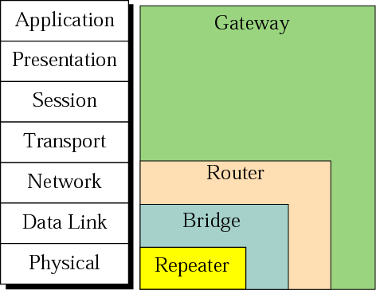
Connecting devices and the OSI model
44

Slide 45

K. M. Aslam Uddin
Assistant Professor (ICE)
Noakhali Science and Technology University
45
*
Notes:
45

